Slide 1
Developing Kingdom Leaders: A Brief History and Biblical Mandate

Slide 2
OLD TESTAMENT
Moses and…. God
Moses & Joshua
Judges
Time of Kings
Saul, David, Solomon

Slide 3
NEW TESTAMENT
JESUS:
12
3
APOSTLE PAUL:
Silas
Barnabas
Timothy

Slide 4
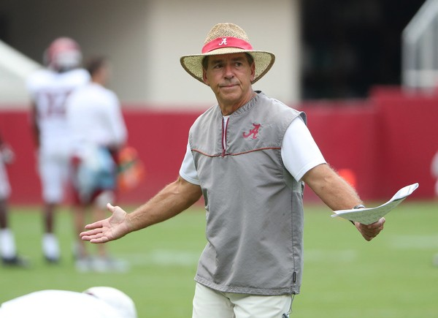

Slide 5
EARLY CHURCH: 1ST– 3RD CENTURIES

Slide 6
“The presbytery must be tender-hearted, merciful toward all, turning back the sheep that has gone astray, visiting the sick, not neglecting the widow or orphan or poor man”
- Polycarp

Slide 7
PATRISTIC ERA: ST. AUGUSTINE

Slide 8
PATRISTIC ERA: KEY SHIFTS
Standardized formation
Development in community
Focus on community

Slide 9
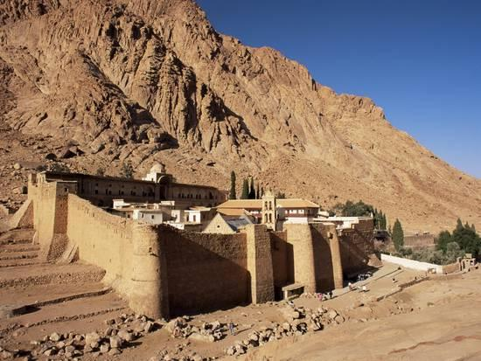
MONASTICISM

Slide 10
MONASTIC ERA: KEY SHIFTS
Focus on manual labor and sustainability
New emphasis on clerical literacy

Slide 11
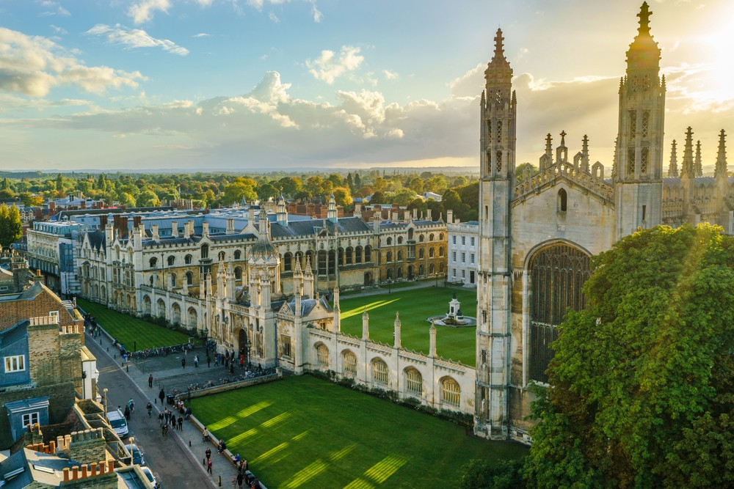
MIDDLE AGES: UNIVERSITIES & SEMINARIES

Slide 12
The gifts he gave were that some would be apostles, some prophets, some evangelists, some pastors and teachers, to equip the saints for the work of ministry, for building up the body of Christ…

Slide 13
DEVELOPED STUDENTS DEMONSTRATE
UNITY: “I am part of a larger Story”
…until all of us come to the unity of the faith and of the knowledge of the Son of God…

Slide 14
DEVELOPED STUDENTS DEMONSTRATE
MATURITY: “I understand my gifts and limitations”
…to maturity, to the measure of the full stature of Christ…

Slide 15
DEVELOPED STUDENTS DEMONSTRATE
SOUND DOCTRINE: “I understand what I believe and recognize my blind spots”
We must no longer be children, tossed to and fro and blown about by every wind of doctrine, by people’s trickery, by their craftiness in deceitful scheming.

Slide 16
DEVELOPED STUDENTS DEMONSTRATE
PROPER FUNCTION: “I have clear expectations of ministry development, room to make mistakes and a tight feedback loop to improve”
But speaking the truth in love, we must grow up in every way into him who is the head, into Christ, from whom the whole body, joined and knit together by every ligament with which it is equipped, as each part is working properly…

Slide 17
DEVELOPED STUDENTS DEMONSTRATE
GROWTH: “I will bring a healthy (fully developed) version of myself to increased responsibility”
…as each part is working properly, promotes the body’s growth in building itself up in love.

Slide 18
TABLE QUESTIONS: 2 MIN
What have you found effective in connecting students to the larger story of God’s Kingdom in your context?
What are some road blocks that get in the way of making this connection?

Slide 19
TABLE QUESTIONS: 2 MIN
How do students discover both gifts and limitations at your site?
Have you found effective resources and tools to monitor progress made?

Slide 20
TABLE QUESTIONS: 2 MIN
How are students doing in embracing and understanding doctrine?
What is working well, and what areas do you see regularly missed?

Slide 21
TABLE QUESTIONS: 2 MIN
What have you found effective in communicating ministry development expectations?
How do you and your team execute the feedback loop to students?

Slide 22
TABLE QUESTIONS: 2 MIN
How do you determine when a student is ready for more responsibility?
Any helpful stories about how this worked well, or how it went wrong?

