Slide 1
CC+ Becoming a Partner Site

Slide 2
Agenda
Overview of Classical Conversations Plus Program
Administrative Team
Classical Education
CC Plus Courses
Differences Between Dual Enrollment and CC Plus
Partnership Benefits
Partnership Opportunities
Q&A

Slide 3
Classical Conversations Plus/SEU Partnership Overview
Opportunity for homeschool students enrolled with Classical Conversations Challenge curriculum (grades 11, 12) to earn credit from SEU
Utilizes a concurrent enrollment model for assessing student work for SEU credit—SEU faculty provide substantive and engaging feedback
Began in 2016 with 29 initial course enrollments in Spring 2016 to 451 for Fall/Spring 2018/19, with mostly Florida students
Launching a comprehensive national effort for Fall 2019 that complements SEU Partner Sites

Slide 4
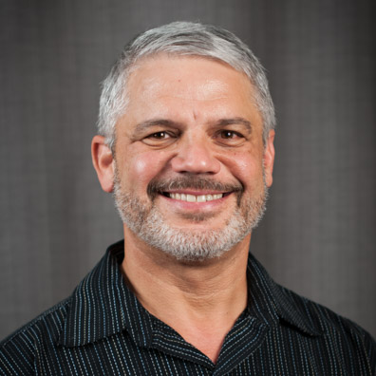
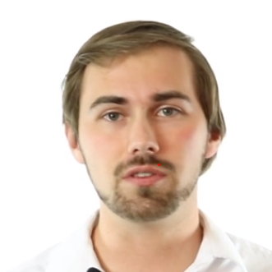
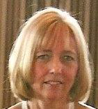
Administrative Team/Contact Info
Meghan Griffin, PhD
Academic Dean
Scott Whitaker, MBA
Director, New Business
Classical Conversations
Joe Childs, DBA
CC Plus Program Director
Will McCreery Manager of CC+
Classical Conversations
Email: wmccreery@classicalconversations.com
Kim Childs, MEd
CC Plus Program Coordinator
Phone: 863-667-5580
Email: ccplus@seu.edu

Slide 5
Classical Christian Education Background
Content: Rooted in the Western Tradition/Classical Antiquity
Subjects and skills essential for a free person
Process: Trivium
Grammar—fundamental rules, language, mechanics, memorization
Logic—ordered relationships, reasoning, critical thinking, practice
Rhetoric—expression, original composition, speech, debate
Socratic method:
Learning through questions; to examine the validity of one’s beliefs
Parents, directors, and students themselves lead

Slide 6
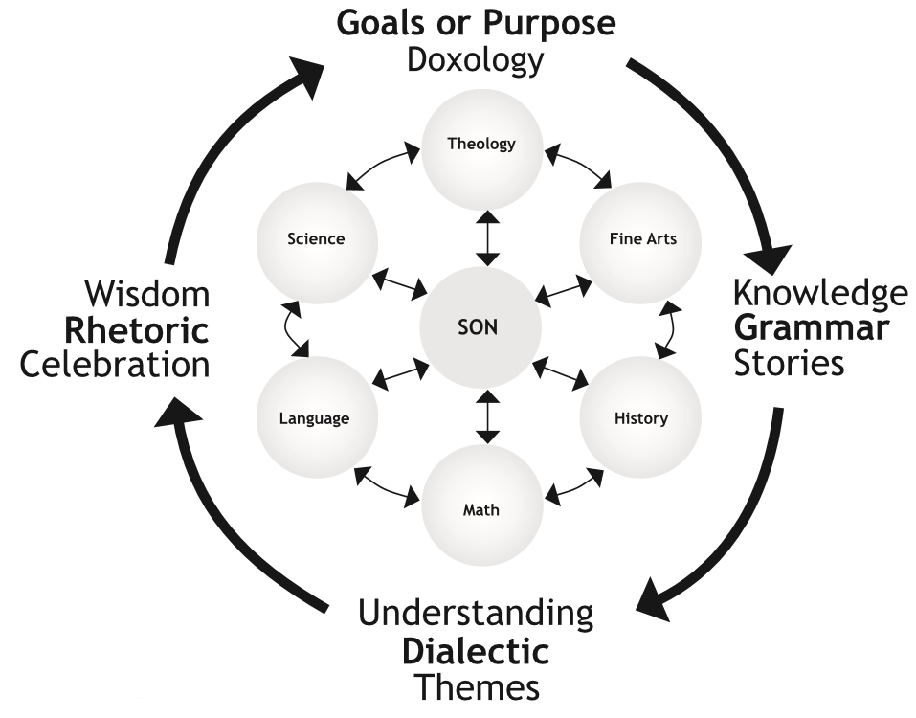
Classical Conversations
Christian homeschool model, with parents highly involved as primary instructors
Directors support parents and facilitate community-based discussions of six subjects with a maximum of 12 students
Parents and directors trained annual/ parent practicum

Slide 7
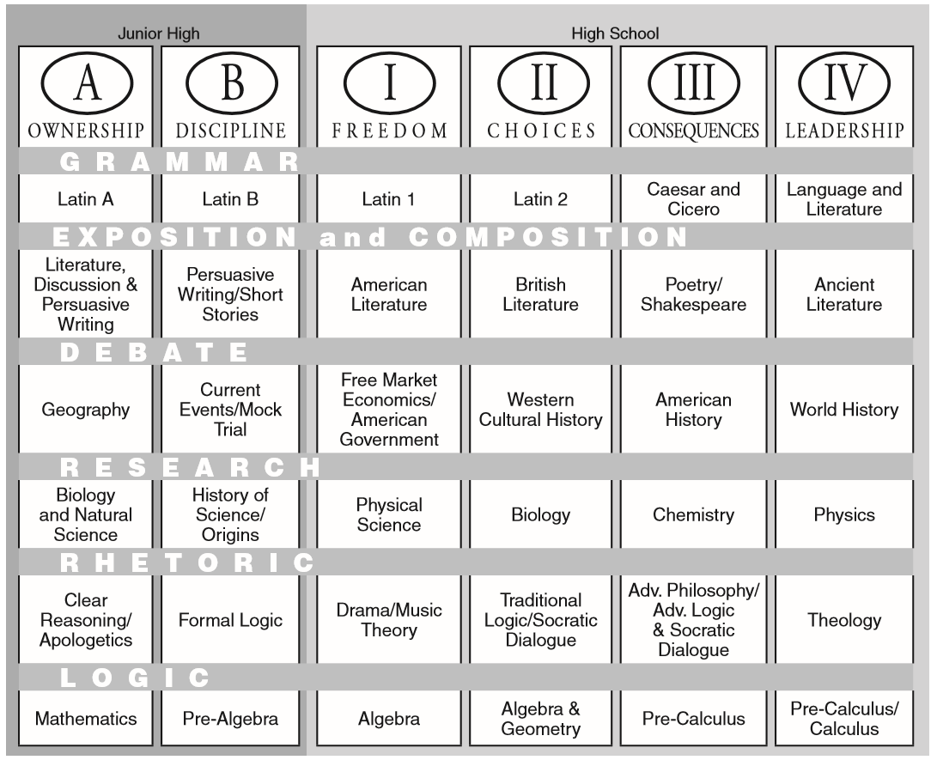
Challenge Curriculum and CCPlus Courses
College Algebra Pre-Calculus
Probability & Stats Data Analysis
English Comp I English Comp II
American Hist. I American Hist. II
Western Civ. I Western Civ. II
Old Testament Christian Thought
Public Speaking Intro to Philosophy
Greek/Rom Lit. Dramatic Interpretation
Ancient Lit.

Slide 8
Dual Enrollment vs. CCPlus
Dual Enrollment
CC Plus
Curriculum
SEU Created Course
Curriculum
CC Challenge Curriculum
Professor Role
Lecture, Engage, Grade
Professor Role
Engage, Assess
College Credit
Location
Site, classroom, or online
Location
CC Community, online
Business Model
Discounted tuition/students enrolled in existing course/pay faculty per course
Business Model
$500 per course/CC does enrollment management/pay faculty per student

Slide 9
Partnership Benefits
Classical Conversations
Increases retention through Challenge IV
Provides enhanced value to its families
Diversifies revenue source
Student
Gains college credit by remaining in CC through high school graduation
Reduces total cost of college tuition
Enhances learning/deeper engagement
Southeastern and Sites
Builds pipeline of students
Extends the mission
Enhances the local and national brand

Slide 10
Ways to Participate as a Partner Site
Provide a weekly meeting place for the once a week communities
Provide a once yearly meeting place for a three day parent practicum
Host a CCPlus Day for local Classical Conversation communities within a reasonable radius of your site
Host other training or information sessions/speakers with topics of interest to this community

Slide 11
Wrap Up
Q&A

